Slide 1

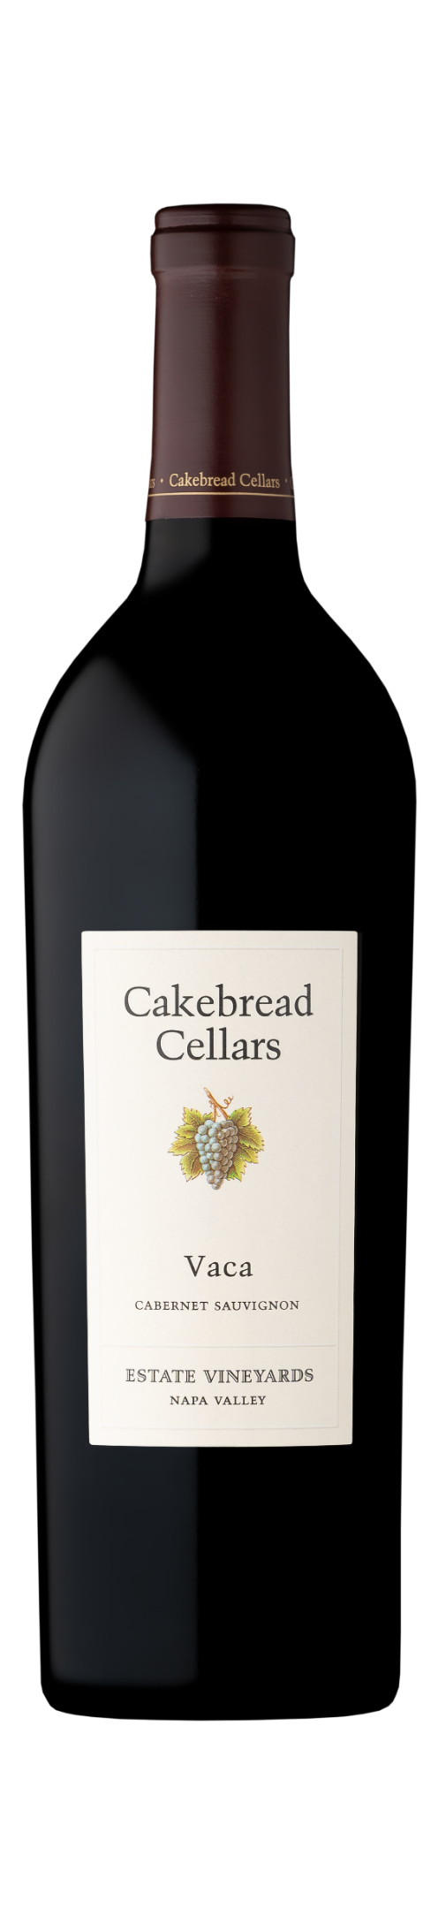
2022
  VACA CABERNET SAUVIGNON
NAPA VALLEY
Our 2022 Vaca Cabernet opens with inviting aromas of dark plum, black cherry, raspberry, and a hint of toasted coconut, layered with roasted coffee and dried herbs. On the palate, rich flavors of chocolate-covered cherries and raspberry jam unfold, accented by subtle floral notes and sweet, toasted oak. Finely-knit tannins lend structure to the mid-palate, while the finish is long and layered, seamlessly blending ripe fruit with warm oak spice..
VINEYARDS & VINTAGE
This wine is made from grapes grown at three of our estate vineyards along the Vaca mountain range on Napa Valley’s east side. Arroyo Creek, the coolest site, is planted among rocky outcrops above the town of Napa. Doggwood, further north, sits in a warm, bowl-like valley with varied exposures. Dancing Bear, the northernmost site, lies high on Howell Mountain with 360-degree exposure. This range of conditions yields a bold, complex Cabernet with vibrant varietal expression and a balanced structure of acidity and tannin.
The 2022 season was mild and even, with summer days characterized by moderate heat and steady ripening. Drought conditions persisted across Napa Valley, allowing the vines to naturally control their vigor and yields, resulting in concentrated flavors and aromas. Warm weather continued through the start of harvest, ensuring that Cabernet Sauvignon reached peak maturity and developed elegant tannins and structure.
WINEMAKING
Each vineyard lot was harvested and fermented separately. Hand-sorted clusters were carefully destemmed, with whole berries hand-sorted a second time to ensure optimal quality. A cold soak preceded fermentation, encouraging gentle extraction of color, aroma, flavor, and structure. The wine was then aged for 18 months in French oak barrels, 58% of which were new, to enhance depth and complexity.
GRAPE VARIETY
89% Cabernet Sauvignon, 8% Merlot, 3% Cabernet Franc
VINEYARDS
54% Arroyo Creek, 37% Doggwood, 9% Dancing Bear Ranch
HARVEST DATES
September 1 – 22, 2022
WINEMAKER
Stephanie Jacobs
NOTES
ALCOHOL | 14.8%
ACIDITY | 0.614G/100 ml
PH | 3.7
BOTTLE | Dec 9-10, 2024
AGING | Aged 22 months in French oak - 57% new, 43% neutral

